Slide 1
Your Nest Pension scheme
Notes:
Speaker introduction
Mark is responsible for building the engagement and supporting proposition strategy with employers, their intermediaries and members. This encompasses the end to end experience from joining the scheme through to a member taking their benefits.
The role includes product and proposition development, research, marketing, member engagement and implementing behavioural and evidence based solutions.
Mark has nearly 30 years’ experience in workplace pensions and has worked for leading providers and consultancies during this time.

Slide 2
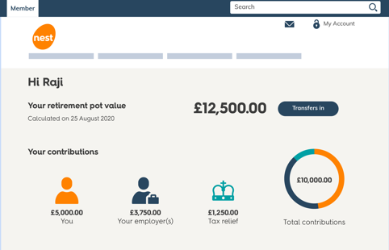
What we’ll cover
Understanding your pension
How to connect with your pension

Slide 3
What is a workplace pension?
Set up to help you save for your future
Nearly 22 million workers now saving into a pension
Invested with an aim of growing it for your later life
Notes:
Every UK employer has to put eligible workers into a workplace pension and contribute towards their retirement. It’s called auto enrolment and it’s a legal requirement.
It helps to save money now so you’ll have a savings cushion to rely on when you’re no longer working.
Millions of workers are now able to save with ‘no fuss’. Payments come out automatically, so you’re putting money towards your future without having to lift a finger.
Pension providers like Nest then put your money to work, aiming to grow it so you have a bigger pot to retire on.

Slide 4
Why do I need a workplace pension?
68
State Pension age is set to increase to 68
£203.85
The state pension is set to increase to £203.85 per week from April 2023
Notes:
Workplace pensions are an effective way to save, helping to build financial security for your future
Looking at this slide, you can see that it’s not unusual for people in the UK to live for at least twenty years after they retire.
That’s twenty years that people will need a steady source of income after they stop working.
And don’t forget, the average UK life expectancy has risen an additional 13 years since 1950.
With life expectancy on the rise, you might need that source of income for even longer than 20 years.
A lot of people plan to rely on the State Pension, so it’s worth looking at what it will actually give you.
Currently the State Pension pays a maximum of £203.85 per week. And you need to have 35 qualifying years of National Insurance contributions on your record to receive the full state pension.

Slide 5
Who pays into my pot?
We
You
Government
Notes:
In most cases your pot is made up of contributions from you, your employer and the government.
For every £80 you put in, the government tops that up to £100 - as long as you’re eligible. And most people are.
Your employer could add even more to your pot, if you’re eligible. They’ll let you know how much they’ll be contributing.
That’s what makes workplace pensions work harder than many other investments – the fact that you get extra money topping up your pot each time you save.
There’s no one-size-fits-all answer for how much you should be contributing. It all depends on your personal circumstances.
However, you’ll find a handy pension calculator on our website that’ll help you work out how much you should be saving to hit your retirement goals.

Slide 6
How Nest supports you
Looks after your
account online
Manages your money carefully
One retirement
pot for life
Easy to
understand
Low
charges
Notes:
Nest is all about making it easy for you to save. What’s more, we’re a non-profit. That means we don’t answer to shareholders or billionaire owners. All our profits go back to you, our members.
These are five ways we work to support you.
You have an online account, making it easier for you to keep an eye on your pension savings.
We carefully manage those savings based on how far off you are from retirement, using our award-winning investment strategy.
You have one pension pot for life which you can pay into if you change jobs. This makes it easier to keep track of your pension savings over your whole career.
We make an effort to explain things clearly, meaning you can easily understand what’s happening to your money.
We have low charges but offer all the services and protection you’d expect from a high-quality pension scheme.

Slide 7



Retirement funds designed around your plans
Nest 2056
Retirement Date Fund
Nest 2040
Retirement Date Fund
Nest 2024
Retirement Date Fund
Notes:
Lots of people don’t know what happens to their money in a pension scheme.
It’s simple.
The money you pay into your pot is put into a fund. We use money in the fund to buy things that our research suggests will increase in value. This could be shares in companies, or property, or even solar farms. When companies we invest in do well or the value of the property has bought goes up, you get a share of the profits and the size of your pension pot increases.
Unless you tell us otherwise, we’ll put your money into one of our Nest Retirement Date Funds. And here’s where Nest is different to most, because there’s one for every year a member could take their money out of Nest.
For example, the current State Pension age is 66. If you’re due to turn 66 in 2056, your pot will be invested in the Nest 2056 Retirement Date Fund. If you’re due to turn 66 in 2040, your pot will be invested in the Nest 2040 Retirement Date Fund.
We’ll invest it based on your age so it’s ready for when you need it.
Don’t forget, the State Pension age is gradually changing over time. If you plan to retire early or would like to keep working past your State Pension age, just let us know. We’ll put you in the right fund to fit your plans.
Ultimately, we want you to have more to spend when you retire.

Slide 8
Your other fund choices
Nest offers choice for those who want it
If you're close to retirement, you may be able to save in the Nest Guided Retirement Fund
Nest Ethical Fund
Nest Sharia Fund
Nest Higher
Risk Fund
Nest Lower
Growth Fund
Notes:
We believe that our Nest Retirement Date Funds are the best option for most members.
However, some people may want their money invested in line with their faith, belief, or attitude to risk. If that sounds like you, we have a range of fund choices that let you decide how your money is invested.
These have been set up for people who want a different approach to risk than the Nest Retirement Date Funds or those who have strong feelings about how their money should be invested. It’s quick and easy to choose a different fund using your online account.
You can find out more about Nest’s other funds on our website.

Slide 9



How is my money managed?
Award-winning
investment strategy
Invested with the impact
on people and the planet
taken into account
Proven to deliver similar
levels of profit while taking
less investment risk than
most pension providers
Notes:
As a member of Nest, you're putting money away for your future. So an important part of our strategy looks at whether your investments are building a future we all want to live in.
We take lots of different issues into account, like whether a company pays its staff the living wage or contributes to climate change. Where possible, we push companies to change their approach to consider the long-term impact of their business.
We believe this approach isn't just better for your pocket – it helps people and the planet we live on, too.

Slide 10
How to connect with your pension

Slide 11
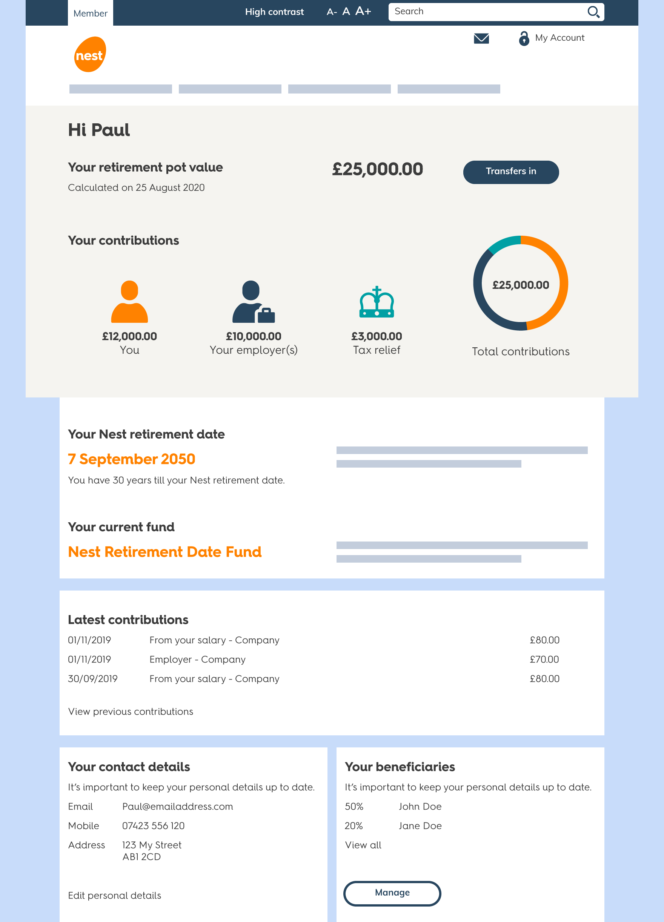
Manage your pension online
Log in to your online account to:
  See how much you’ve saved
  Transfer your pension savings
  Top up your pot
  Keep your contact details up to date
  Tell us who you’d like to inherit your pot
nestpensions.org.uk/login
Notes:
Whether you want to take control of your pension or just let us work for you in the background, it all starts with logging in online.
If you haven’t logged in before, all you need is your Nest ID, which can be found on your welcome letter, or your National Insurance number.
Once you’re in, you’ll see your personalised dashboard, which gives you all the tools and tips you need to manage your account:
See how much you’ve saved
Transfer your pension savings
Top up your pot
Keep your contact details up to date
Tell us who you’d like to inherit

Slide 12
What happens to my pension when I die?
It’s your hard-earned money. So it’s up to you to choose…
one individual
several people
a good cause
any combination of these
Notes:
Adding a beneficiary is one of the most important things you can do.
After all, it’s your hard-earned money sitting in your Nest pension pot, so it’s important that it goes to the people or the good causes that are close to your heart.
Telling us now means we can pay your pot to the people you want to inherit with as little fuss as possible, and in the quickest possible time.

Slide 13
Taking your money out of Nest
You can start withdrawing money from 55 or 57
If you suffer from ill health, you may be able to take your money out early.
Where to find out more:
nestpensions.org.uk/retirement
moneyhelper.org.uk
Keep Nest updated on when you plan to retire.
Notes:
You can start withdrawing money from your pot from age 55 to 57, depending on when you were born
If you suffer from ill health, you may be able to take your money out early
Your plans for the future may change. Keep Nest updated on when you plan to retire so they can get your pension ready at the right time.
Managing your pension could be on of your biggest financial decisions. For more information, you can visit Nest’s website at nestpensions.org.uk/retirement, or Moneyhelper moneyhelper.org.uk

Slide 14
Log in now at nestpensions.org.uk
© Nest Corporation 2023. All rights reserved.
This information does not constitute financial, investment or professional advice and should not be relied on.
We do not make any personal recommendation or give advice to employers and their workers or third parties on how to make investment decisions. If you are considering using Nest you should consider talking to an appropriately qualified professional.
We do not give any undertaking or make any representation or warranty that this document is complete or error free. We do not accept responsibility for any loss caused as a result of any error, inaccuracy or incompleteness.
Any form of reproduction of all or any part of these slides is not allowed.
201003 05/23
Notes:
Thanks for listening.
Hopefully this talk has given you all you need to know to take control of your Nest pension.
You have all the tools you need, only a few clicks away.
Why not log in now and get started?

